Slide 2
Choosing the path of pain:
A Plugin System in Rust
Notes:
Welcome to my showcase of “Choosing the path of pain”, also known as “A plugin system in Rust”

Slide 3

About myself
🧍 Mario Ortiz Manero
📚 Last year Computer Science in Spain
❤️ Open source enthusiast
🦀 Wanted more real-world experience
📧 marioortizmanero@gmail.com
🌎 https://nullderef.com
📍 Dolomites, The Alps
Notes:
Computer Science Student at University of Zaragoza, which is in Spain
Always loved Open Source, worked on many projects of my own and also others out there
Wanted more real-world experience in terms of programming
Applied because I thought this mentorship combined the best of both worlds

Slide 4

What’s Tremor?
“An early-stage event processing system for unstructured data with rich support for structural pattern-matching, filtering and transformation.”
Notes:
For the mentorship, I worked with Tremor:
Basically an EPS
Intends to be pretty fast
Lots of cool features for the basic operations: pattern-matching, filtering & transformation

Slide 5
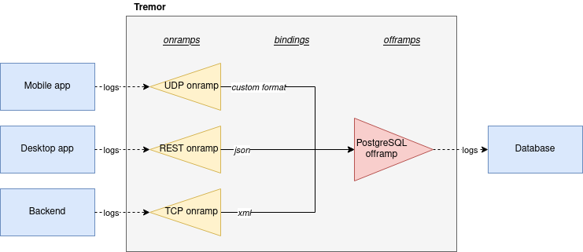
What’s Tremor?
Typical example:
Collecting and transforming logs from different applications into a single database
Notes:
System with multiple applications
Logs in different formats and different protocols
Filtered and transformed into the same format
Saved in a database for later analysis

Slide 6
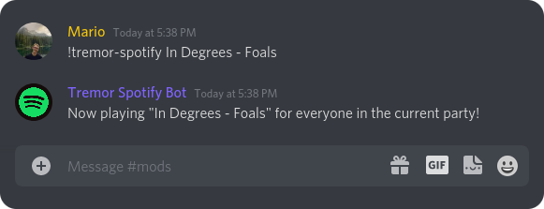
What’s Tremor?
But also possible:
A Discord bot with commands to control Spotify*
*unimplemented yet
And more!
Notes:
The limit is your imagination
Taking Discord commands as the input
Transforming and filtering them however is needed
Outputting it as Spotify commands to control the Spotify player

Slide 7
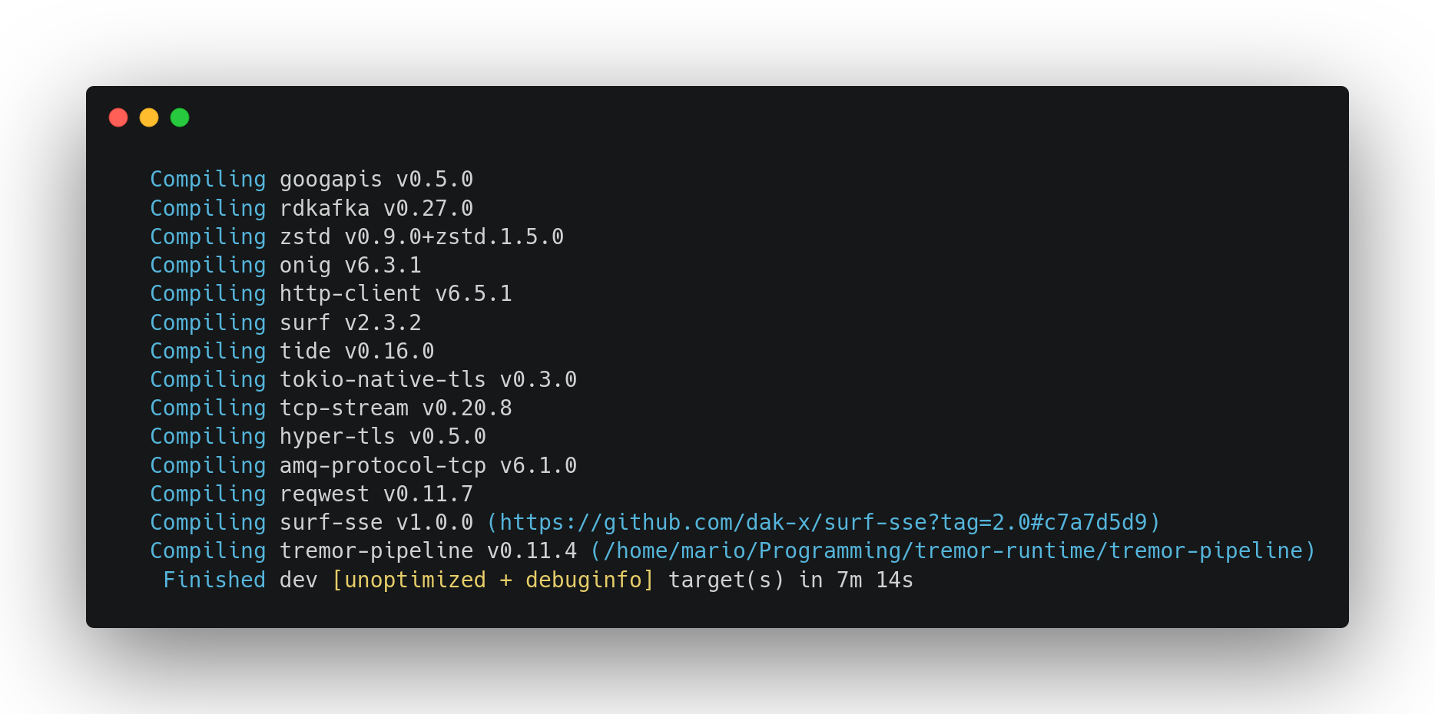
Why a Plugin System?
Notes:
Main issue:
Compilation times were bad
When I started it was > 7 mins
Would only get worse
Even incremental changes are 10s
Not a good developer experience

Slide 8

Why a Plugin System?
Discord connector
Spotify connector
YAML codec
base64 postprocessor
Notes:
Another thing that comes with plugin systems is modularity
Decoupling deployment of executable and components
Some things are updated more regularly than others
It’s good to be able to treat them separately

Slide 9


Why a Plugin System?
Notes:
Other mature projects with similar requirements have been benefitting from a plugin system
Good idea to at least try

Slide 10



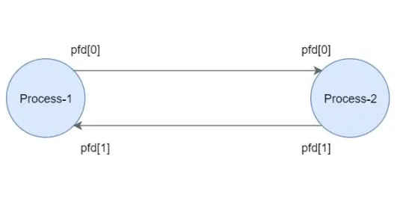
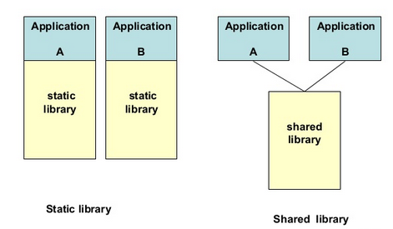

Why “choosing the path of pain”?
Many approaches:
Scripting languages
WebAssembly
Inter-Process Communication
Dynamic loading
The only one performant enough for Tremor is “dynamic loading”
Notes:
Many ways to implement a plugin system
You can see most of them in there
The only one that ended up being performant enough was dynamic loading

Slide 11

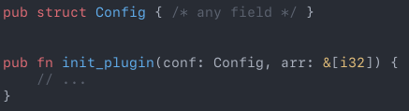
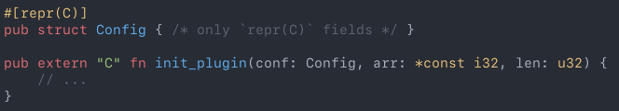
Why “choosing the path of pain”?
…but dynamic loading isn’t even possible with plain Rust
Basically, we need to write C with Rust for the interface
A plugin in an ideal world
A plugin in the real, dream-shattering world
Notes:
What wasn’t very clear since the beginning: not really possible with plain Rust
For both good and bad reasons
Interface has to be written with C in Rust
Not as pretty, safe or easy

Slide 12
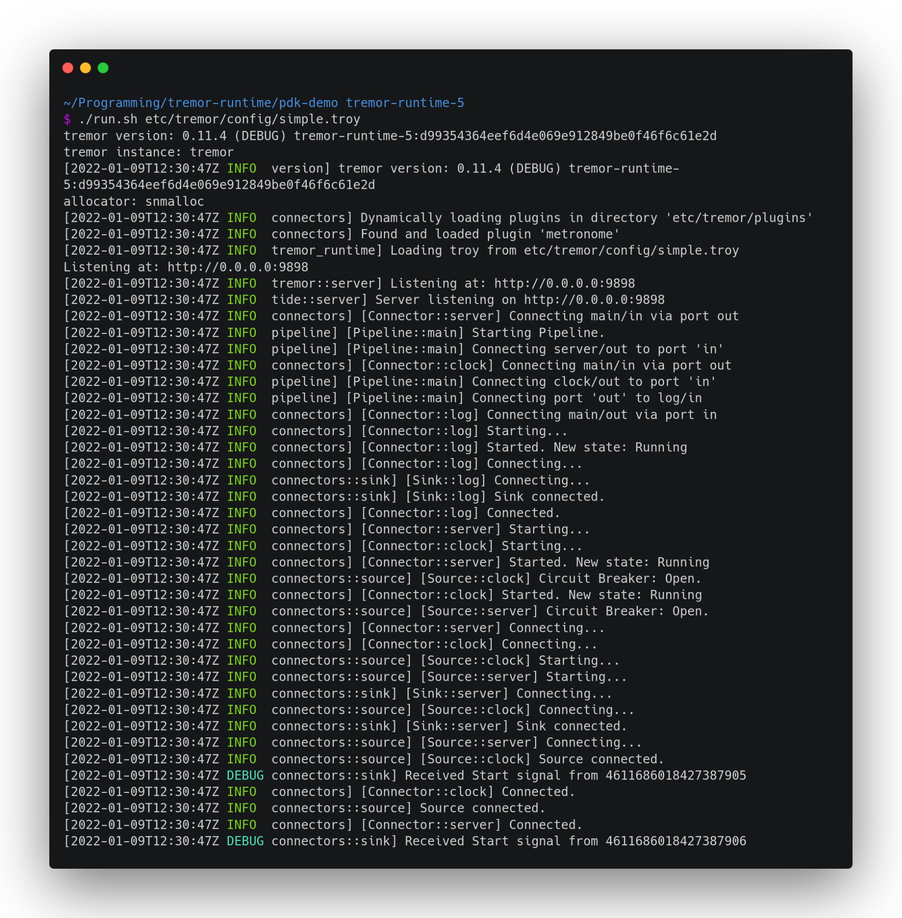
The results
It works!
Still not in production, though
Notes:
Happy with being able to run it
Also being able to compile it in the first place
Far from perfect, still not in production
But a good basis for what the plugin system could look like in the future

Slide 13

The results
Notes:
Usability not as bad as I thought, even though low-level, C
With enough macros, abstractions and tooling it gets better

Slide 14
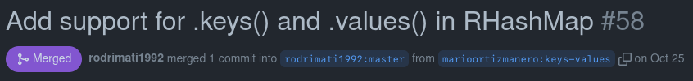
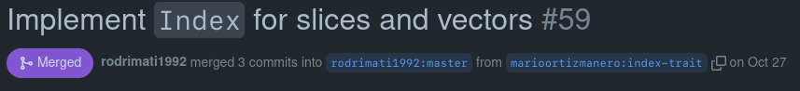
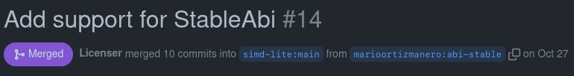
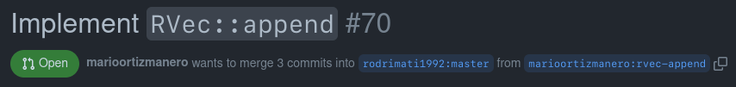
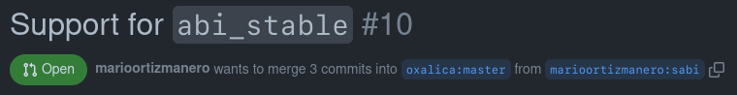
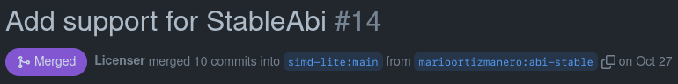
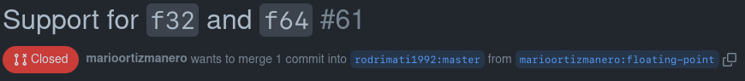
The results
Notes:
Contributions to upstream dependencies
Very happy for helping the Rust community

Slide 15
What I learned
📖
1. Researching on my own
About dynamic loading, ABI stability, etc
📝
2. Note-taking
https://nullderef.com/series/rust-plugins/
🦀
3. Rust in depth
Lots of prototypes & the final implementation
🗄️
4. Organization
Issues, PRs, Kanban
Notes:
Knew Rust
No clue about a plugin system could be implemented nor about dynamic loading

Slide 16
What I learned
📖
1. Researching on my own
About dynamic loading, ABI stability, etc
📝
2. Note-taking
https://nullderef.com/series/rust-plugins/
🦀
3. Rust in depth
Lots of prototypes & the final implementation
🗄️
4. Organization
Issues, PRs, Kanban
Notes:
Wrote my research on a personal blog I created
Useful not only for me (organizing myself, remembering things)
But also for others who want to implement something similar in the future
And even my mentors to see how I’m doing
Recommend to everyone watching this

Slide 17
What I learned
📖
1. Researching on my own
About dynamic loading, ABI stability, etc
📝
2. Note-taking
https://nullderef.com/series/rust-plugins/
🦀
3. Rust in depth
Lots of prototypes & the final implementation
🗄️
4. Organization
Issues, PRs, Kanban
Notes:
Apart from the code itself,
Had never really tried to program in such a huge and scary codebase

Slide 18
What I learned
📖
1. Researching on my own
About dynamic loading, ABI stability, etc
📝
2. Note-taking
https://nullderef.com/series/rust-plugins/
🦀
3. Rust in depth
Lots of prototypes & the final implementation
🗄️
4. Organization
Issues, PRs, Kanban
Notes:
Initially just in the issues & PRs because the task was small enough
I later needed to use tools such as Kanban

Slide 19
My experience
Start
Learn
Notes:
Skills are nice, but the experience is the important part
In terms of development, this diagram
Start by learning as much as possible
This was actually the lengthiest part

Slide 20
My experience
Start
Learn
Experiment
Notes:
Implement smaller, self-contained experiments

Slide 21
My experience
Start
Learn
Experiment
Implement
Notes:
Start developing on the actual scary codebase

Slide 22
My experience
Start
Learn
Experiment
Implement
Fail
Notes:
But then you fail. (dramatic pause, next slide)

Slide 23


My experience
Start
Learn
Experiment
Implement
Fail
Notes:
Catastrophically. (dramatic pause, next slide)

Slide 24

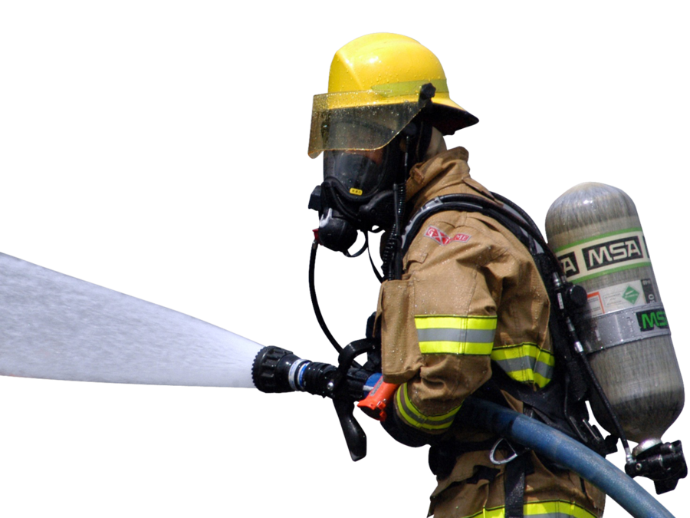
My experience
Start
Learn
Experiment
Implement
Fail
Notes:
You learn from it, look for new approach

Slide 25
My experience
???
Success
Start
Learn
Experiment
Implement
Fail
Notes:
Eventually you arrive to something good enough
Advice: learn from your mistakes; failure is the path to success

Slide 26




My experience
Matthias
Darach
Heinz
Notes:
In terms of communication, my mentors were a key
Matthias is the official one
Also got tons of help from Darach & Heinz
Advice: Take advantage of your mentors!

Slide 27


What’s next?
Short-term
You can continue contributing to the project, it's open source!
(it works)
Notes:
Personally not done, decided to make this my Final Year Project
That’s the beauty of open source, you can continue contributing
Benchmarks, tests, getting ready for deployment, polishing

Slide 28

What’s next?
Long-term
Open source friendly
Healthy work-life balance
Open mindedness
Backend or low-ish level coding
Notes:
Always liked CS, but never known what job
Tremor helped me find what a great job would look like:
Open Source friendly
Healthy work-life balance, open mindedness
Backend or low-ish level coding

Slide 29


Thanks to…
The Rust open source community for the help
All the Tremorites out there for bearing with me
The Linux Foundation for making this possible
Mario Ortiz Manero
marioortizmanero@gmail.com
https://nullderef.com

